Slide 1
Consumer Behavior 15.847
Spring 2022
Class 1 - Introduction

Slide 2
What is consumer behavior? Why is it important?

Slide 3
Consumer behavior
“The study of the processes involved when individuals or groups select, purchase, use, or dispose of products, services, ideas, or experiences to satisfy needs and desires.”
To understand consumer behavior, we need to understand human behavior

Slide 4

People act rationally to maximize money

Slide 5
A realistic model of human behavior is important for predicting…
Consumers’ choices
Employees’ choices
Your own choices

Slide 6

Why we think we make decisions
What we don’t realize affects our decisions

Slide 7
Theoretical Frameworks
Experimental Evidence
Applications

Slide 8
People act rationally to maximize money

Slide 9
Often irrational

Slide 10
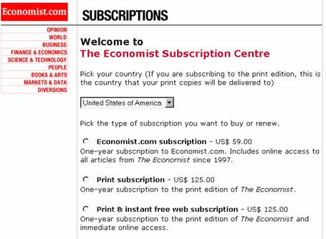
28%
0%
72%
57%
43%

Slide 11
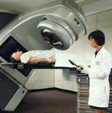
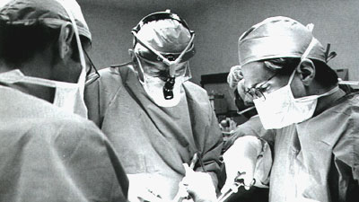
Radiation
Surgery
Percent of
doctors who
preferred
surgery
10% of patients die during surgery
90% of patients survive the surgery
McNeil et al (1982)
Notes:
Surgery has a better chance of eliminating all the cancer, but there is some risk of dying during the surgery.
10% dying doesn't sound so good. 90% survival sounds pretty good.
This is scary and important stuff!!!!

Slide 12
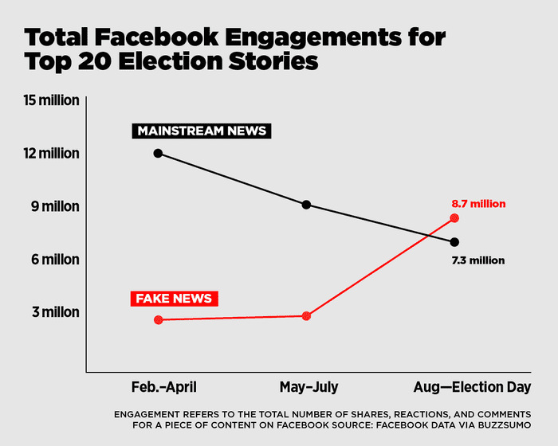
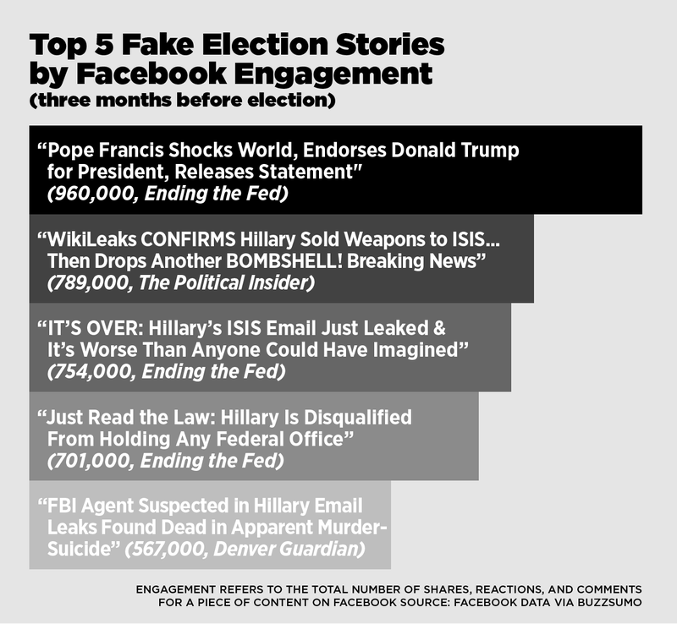

Slide 13
Often irrational
More than making money

Slide 14


Slide 15


Slide 16


Slide 17


Slide 18
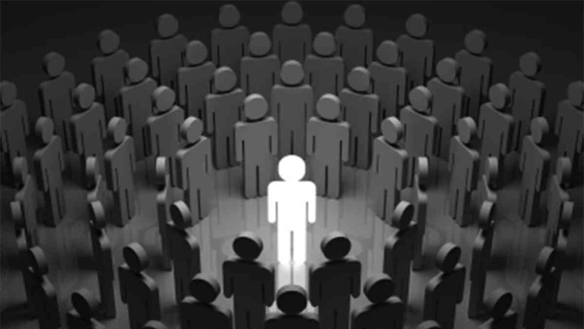

Slide 19
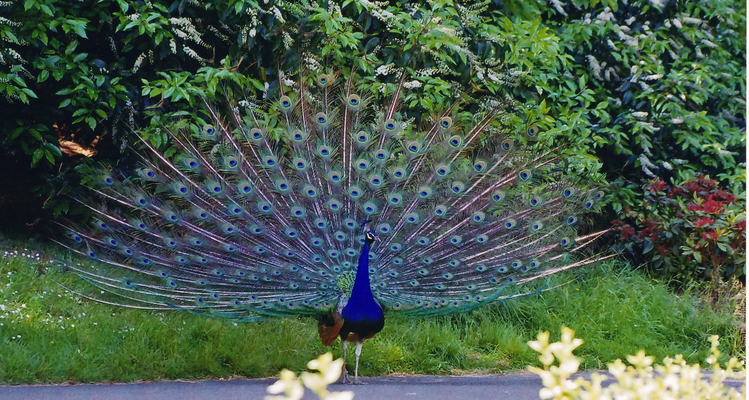

Slide 20
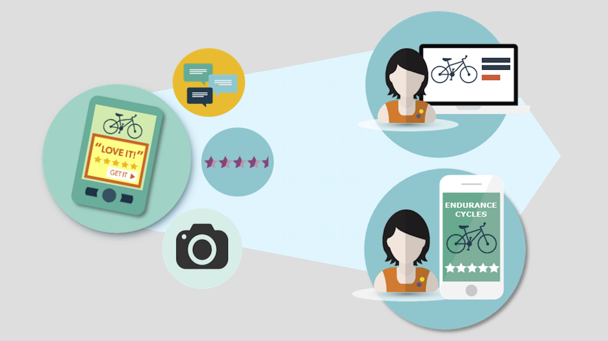

Slide 21


Slide 22


Slide 23
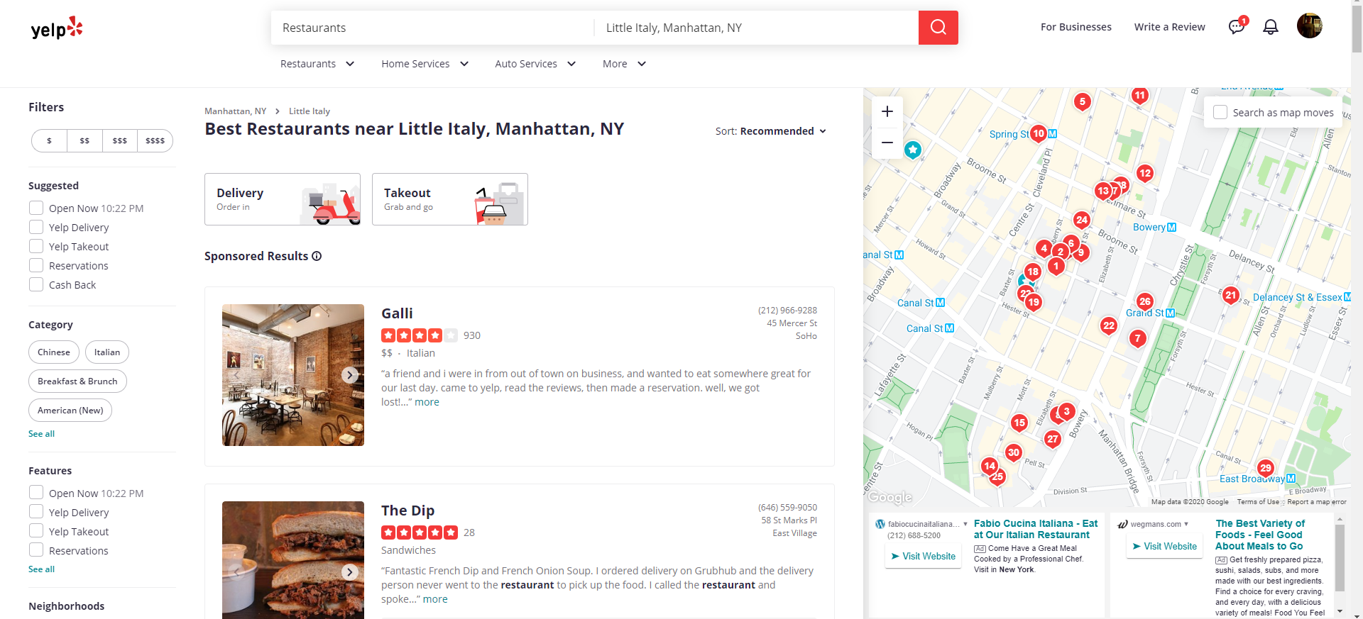
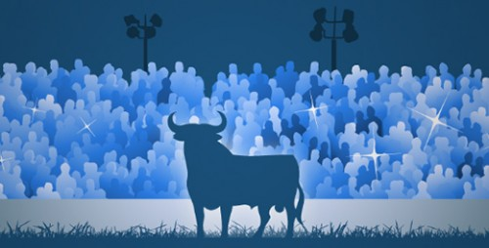

Slide 24


Slide 25
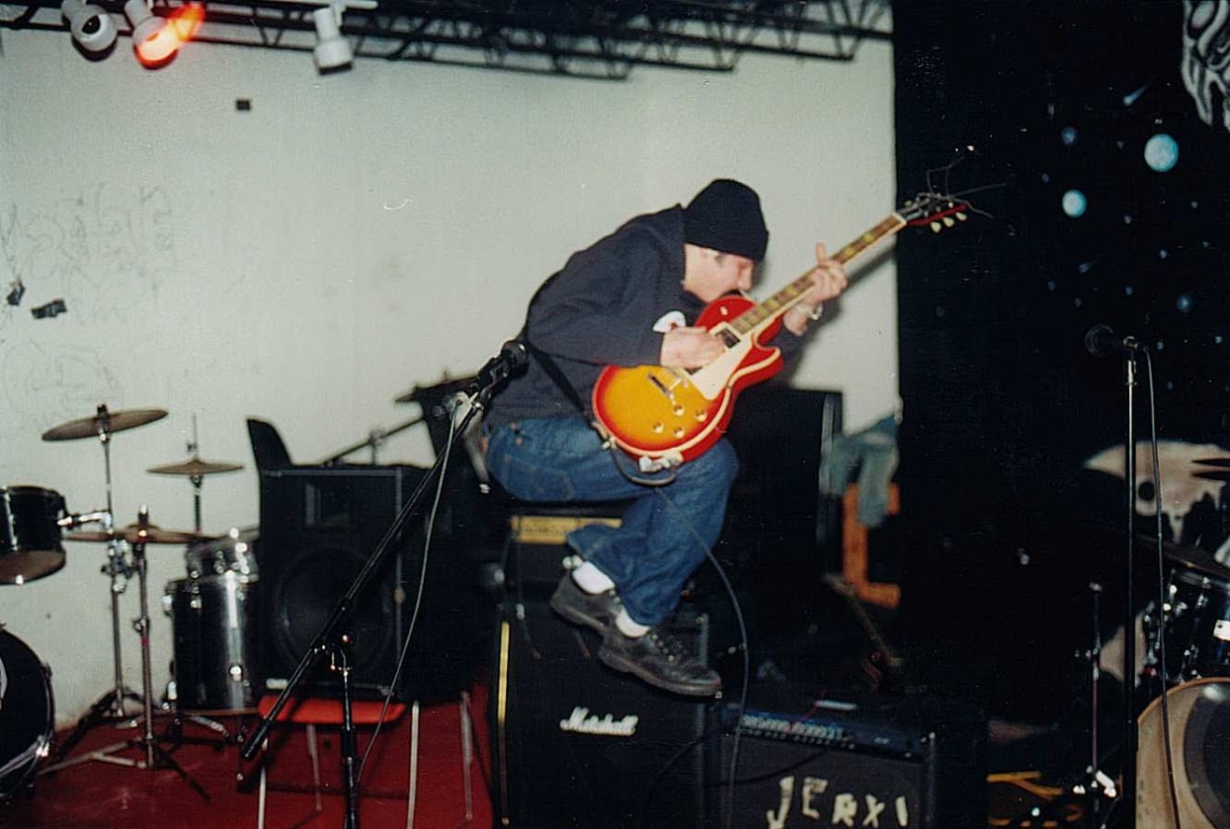




Who I am

Slide 26




Slide 27
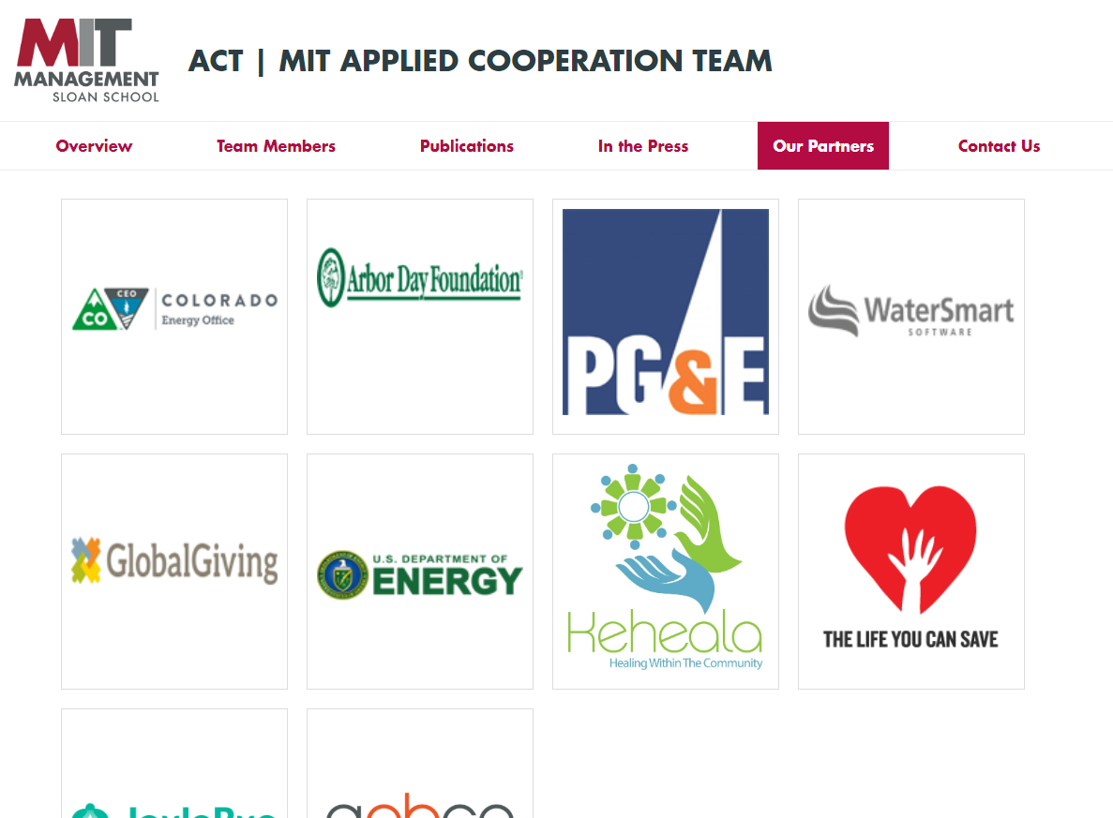

Slide 28
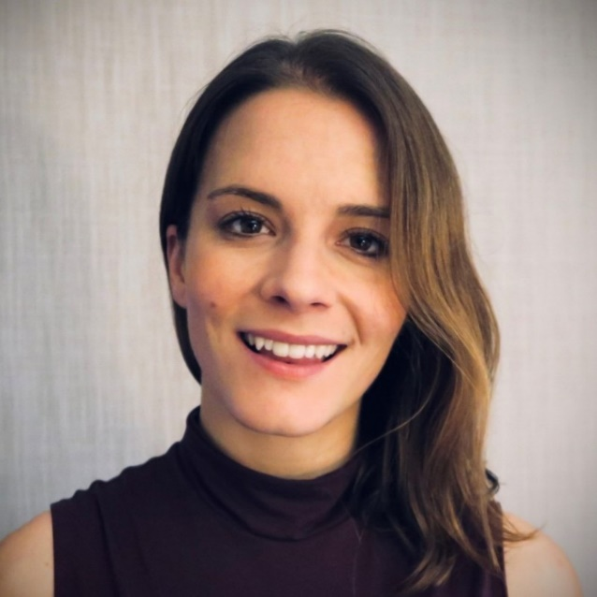
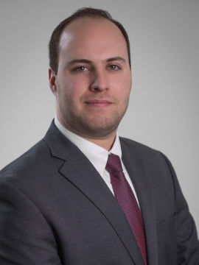
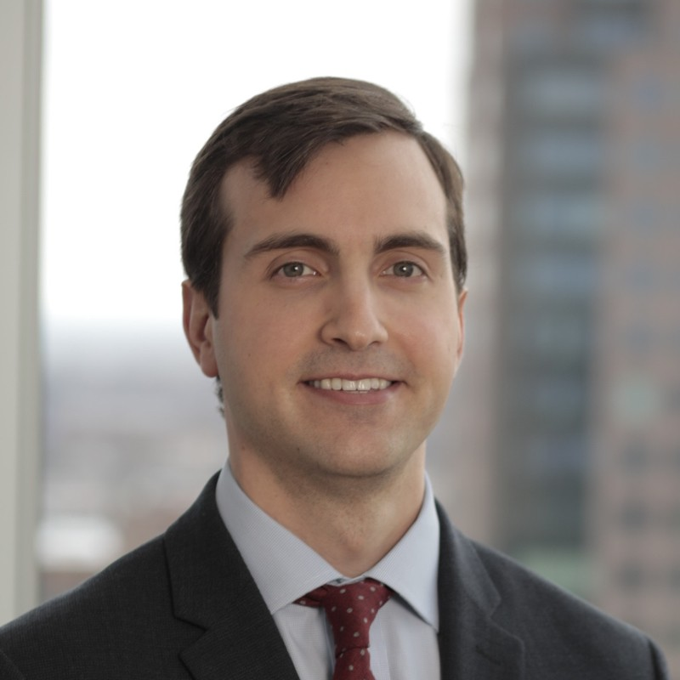
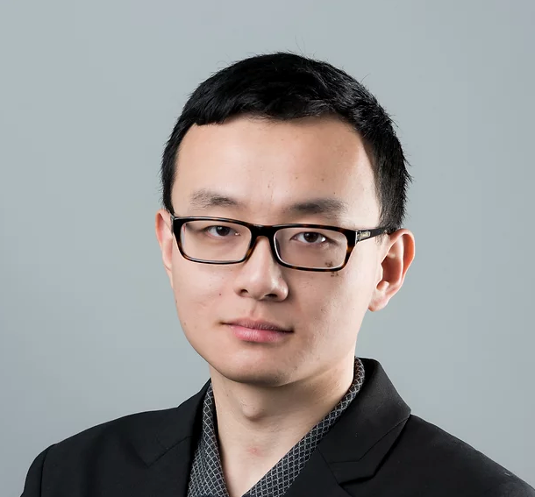
TAs: Emma Gillman Harrison Bacon
Jerry Zhang

Slide 29
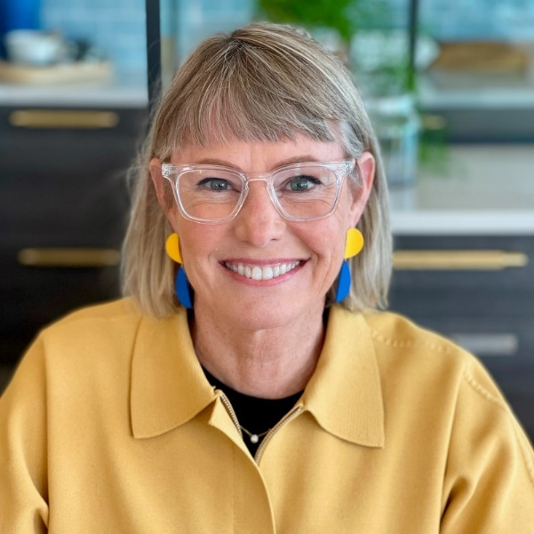


Guest speakers
Jules Pieri
Co-Founder & CEO, The Grommet
Investing Partner, X-Factor Ventures
Entrepreneur in Residence, HBS
Rocky Cole
Research Program Manager
Jigsaw / Google
Mike Egesdal
Senior Data Scientist
Airbnb
[Provisional]

Slide 30
Assignments
20% = Team brainstorming presentations Teams of 5, create 3 min presentation before class, present in class
5% = Case quizzes Survey before each case to assess understanding
10% = Case write-ups 1-2 page writeup of key take-homes/learning points
15% = Mid-term papers Developing marketing campaign applying a concept from class a specified application domain
15% = Final (un)paper Teach future colleague about a key concept you learned & why it matters for your work, using whatever media you want except for a standard essay (e.g. podcast, photo exhibit, op-ed, poem, etc)
20% = Team final presentation Redesign of an existing marketing tactic or message (broadly defined), or novel investigation of a phenomenon relevant to consumer behavior; propose a test of the effectiveness of your idea. Final projects presented at end of semester.
15% = Participation: Attend class and participate in classroom discussions. Answering questions and participating in discussions during lectures is a key part of this class!

Slide 31
Teams of ~5 people
Need to be formed by Wed 2/9 (first brainstorm is 2/14)
Spreadsheet link will be put on Canvas
Resist temptation to form teams with only people from your industry! And try to mix undergrads and grad students
Introductions: Name, Program if not MBA, Industry

